Slide 1
Risk Factors Related To Suicide
There are a lot of personal connections within the local Slavic community. Because of this, almost everyone knows everyone and people are very slow to express their feelings. People hold things in which severely delays their healing/overcoming process.
Many Slavic people go through the motions at community/church to satisfy their parents, pastors, and community preconceived ideals of what’s expected of them, while they are secretly struggling and suffering with crippling depression, addiction, suicidal thoughts, etc.

Slide 2
Protective Factors Related To Suicide
Over the last years Slavic community/churches have made much more progress in recognizing the signs of mental illness and accepting/providing appropriate support.
Persons who attend religious services/churches regularly less likely to commit suicide (access to a support network, less isolated, more communication/connectedness, emotional and spiritual support/encouragement, etc).
Strong connections to family.
Cultural and religious beliefs that discourage suicide (unacceptable, sinful, etc.)

Slide 3
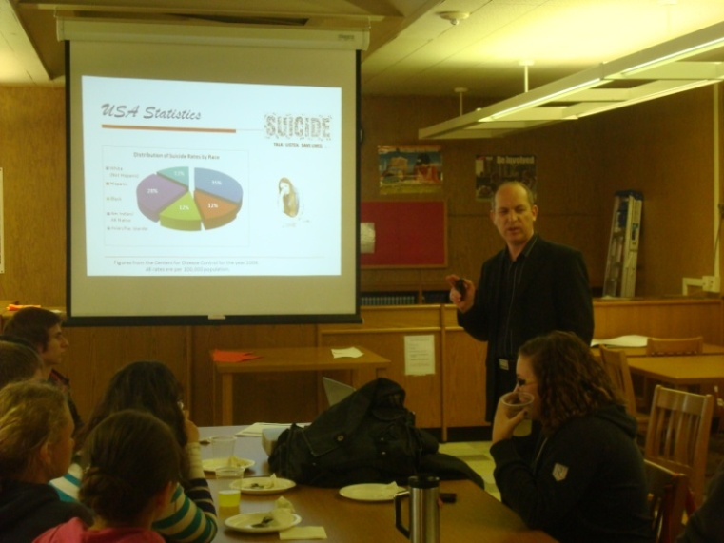
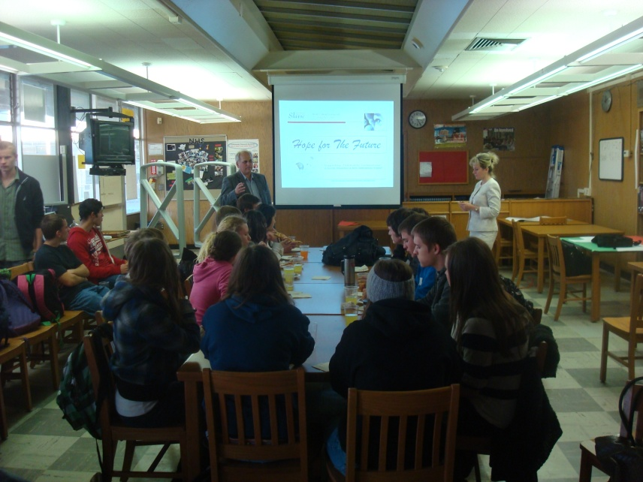
Culturally Appropriate Engagement Strategies/ Focus groups
FOCUS GROUPS for older adults, adults and youth.
Futures High School (Charter School serving the Slavic community.)

Slide 4
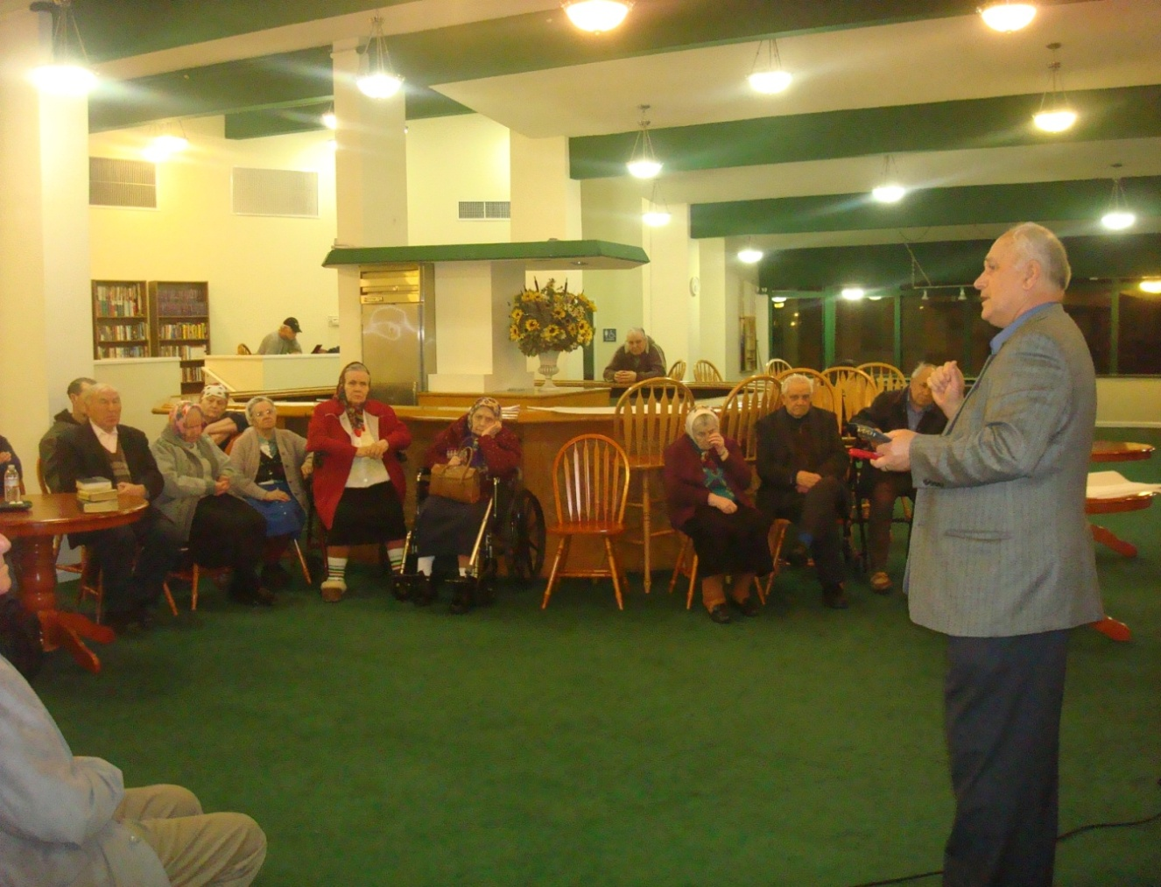
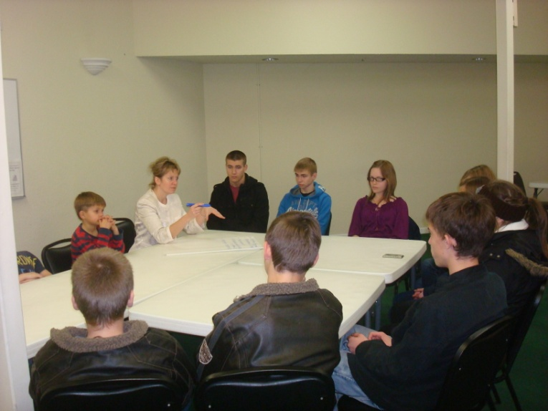
Culturally Appropriate Engagement Strategies/ Focus groups
FOCUS GROUPS for older adults, adults and youth.
Ladi Senior Apartment Complex with large number of Slavic residents.

Slide 5
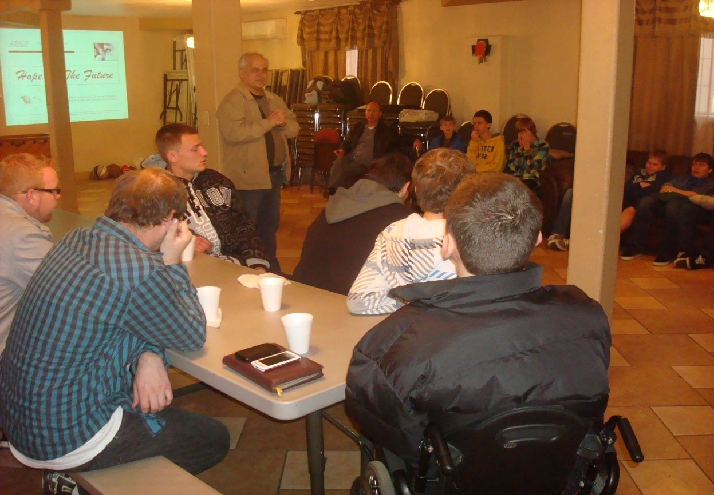
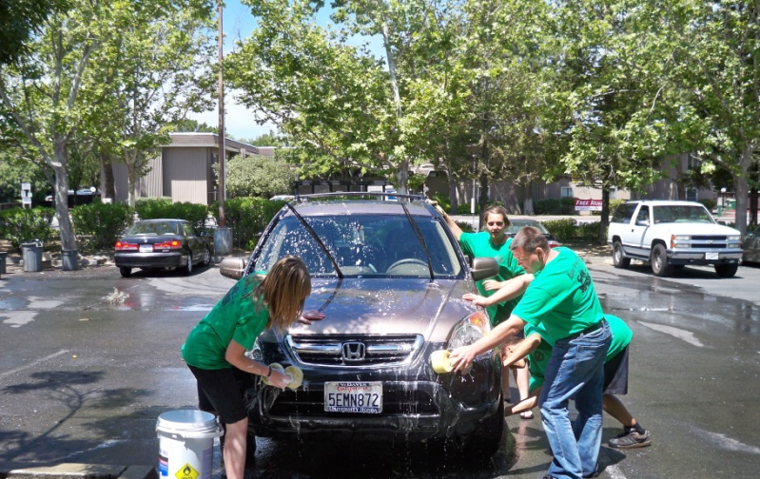
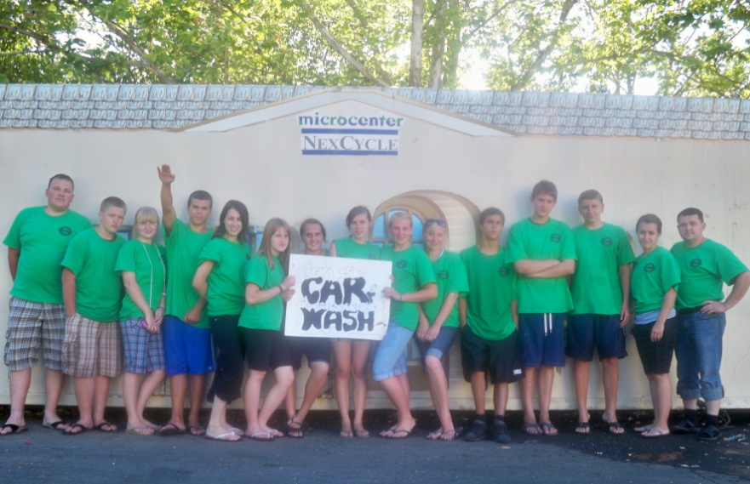
Culturally Appropriate Engagement Strategies/ Peer Clubs
PEER CLUBS for older adults, adults and youth.
Youth Club
Promoting social connections and better understanding of different age groups…

Slide 6
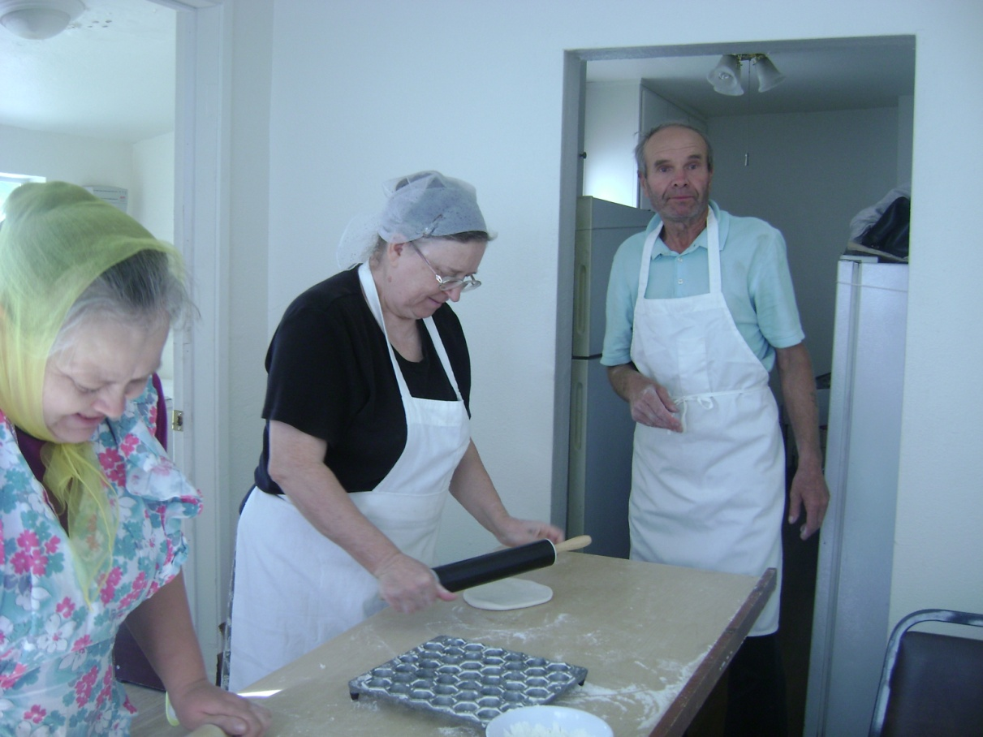
Culturally Appropriate Engagement Strategies/ Peer Clubs
PEER CLUBS for older adults, adults and youth.
Older people share their life experience with youth and young adults; better understanding of young population; reducing depression and suicide…

Slide 7
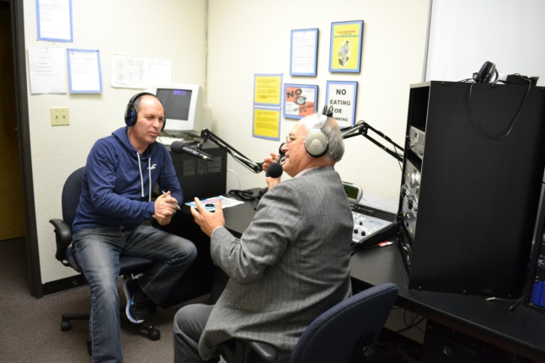
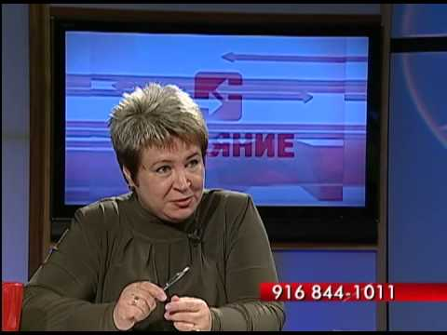
Culturally Appropriate Engagement Strategies/ Radio/TV Programs
RADIO/TV PROGRAMS
on topics of mental illness, stigma discrimination and suicide prevention with an estimated listener base of 35,000
1690 AM (KFSG), InteRradio, TV “Impact”

Slide 8
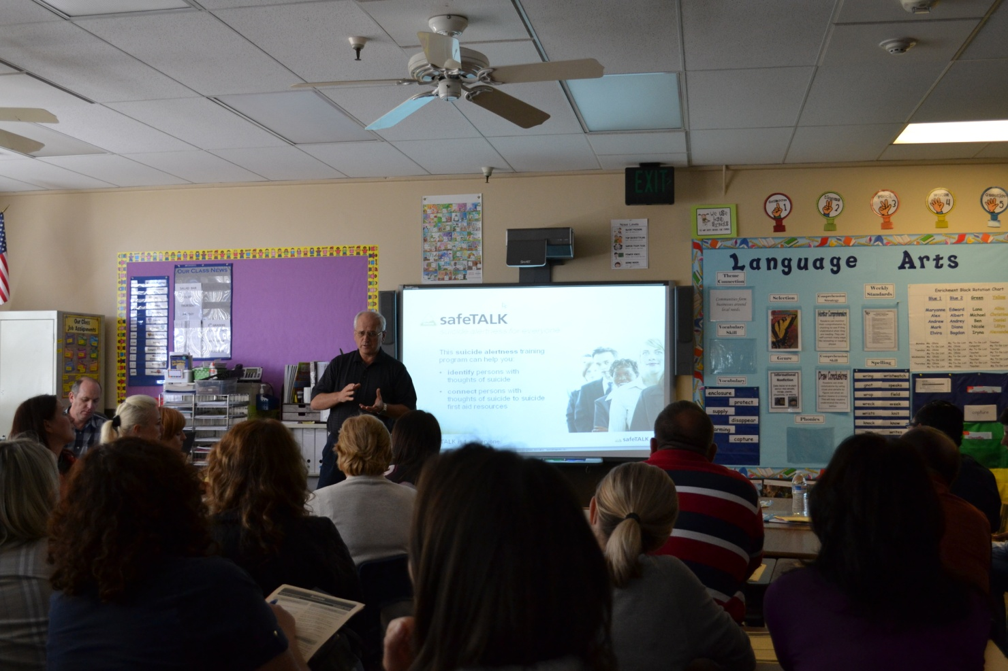
Culturally Appropriate Engagement Strategies/ “SafeTalk” Trainings
SAFETALK TRAININGS
“LivingWorks”
Community Outreach Academy Charter School (Training for 50 Classified Educators )

Slide 9
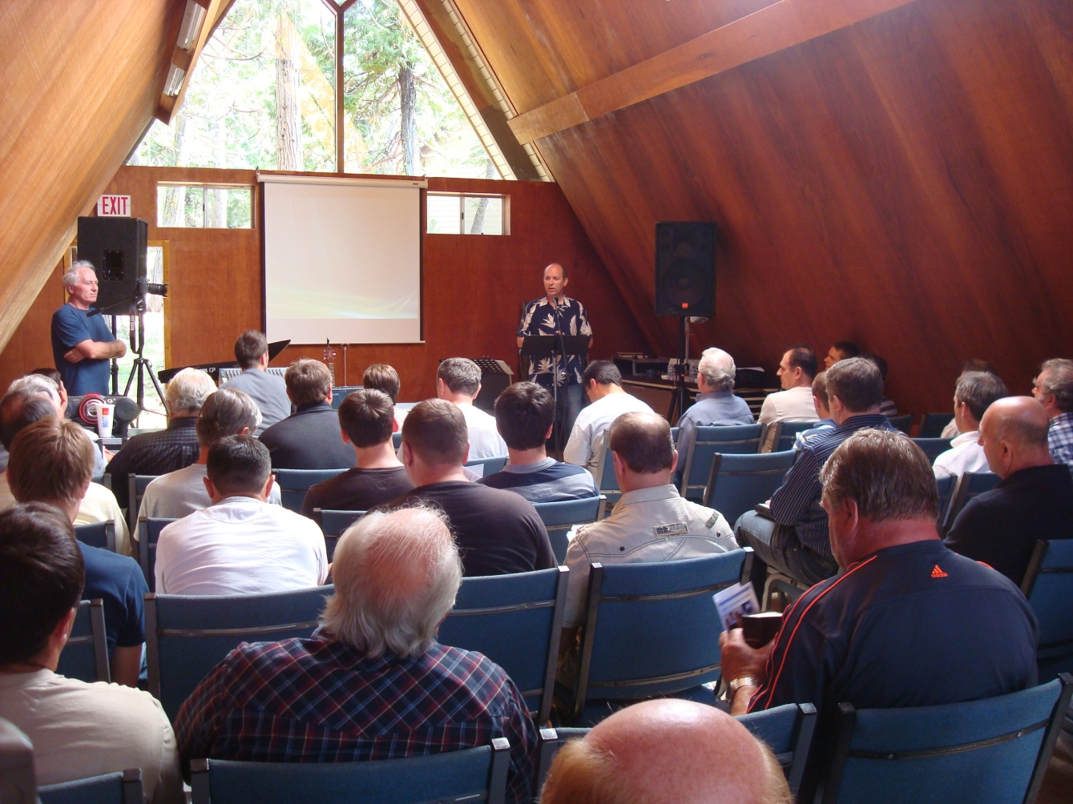
Culturally Appropriate Engagement Strategies/ MH Educational Workshops
WORKSHOPS
MH Educational Workshops for older adults, adults and youth.

Slide 10
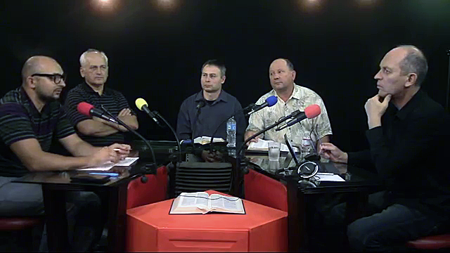
Roundtable on Mental Illness (with Pastors)

Slide 11
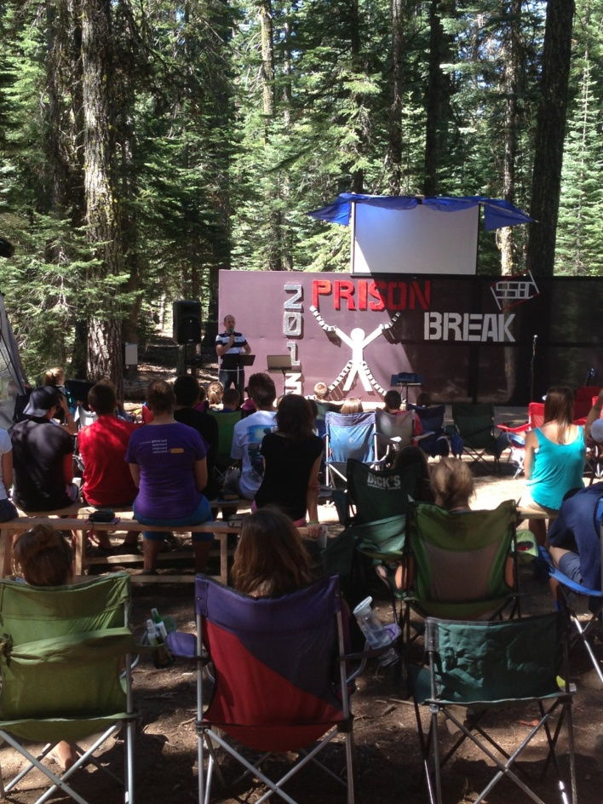
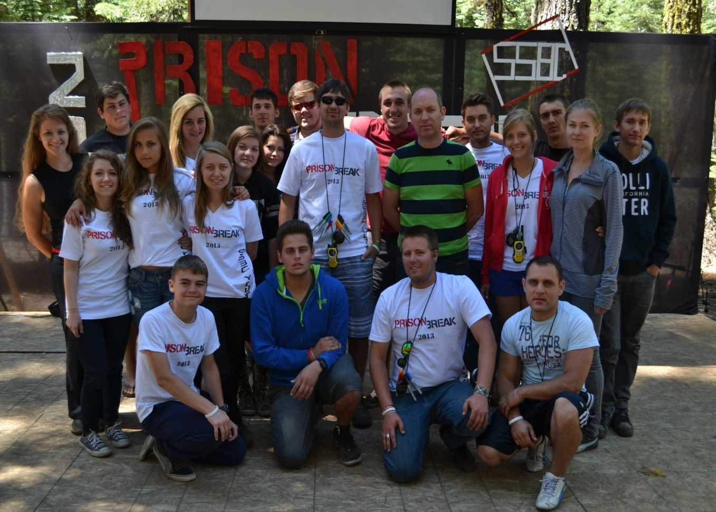
Culturally Appropriate Engagement Strategies/ MH Workshops
WORKSHOPS
“Prison Break” Youth Summer Camp (helping Slavic youth to overcome addictions; suicide prevention, mental health, etc.)

Slide 12
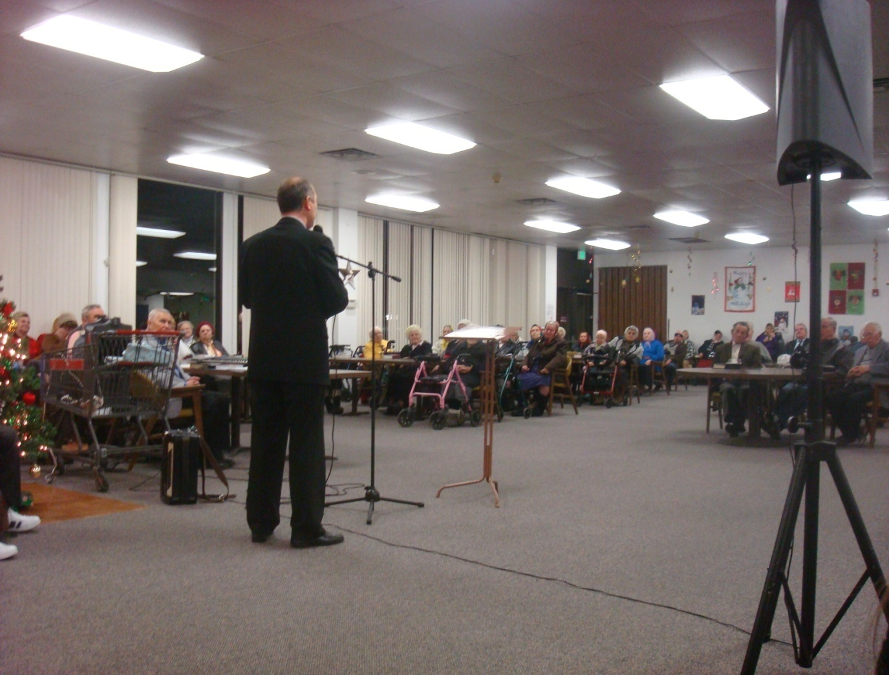
Culturally Appropriate Engagement Strategies/ MH Workshops
WORKSHOPS
Senior Apartments with large number of Slavic residents (701 Fairgrounds Drive)

Slide 13
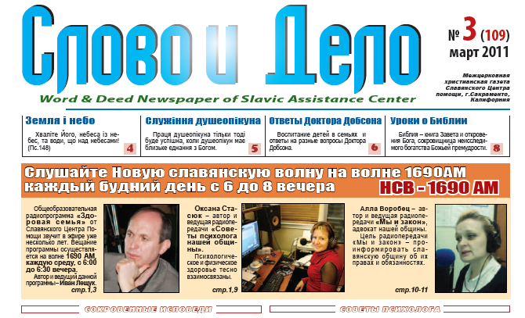
Culturally Appropriate Engagement Strategies/ Slavic Newspapers Articles
PUBLICATIONS
“Diaspora”
“Word and Deed”

Slide 14
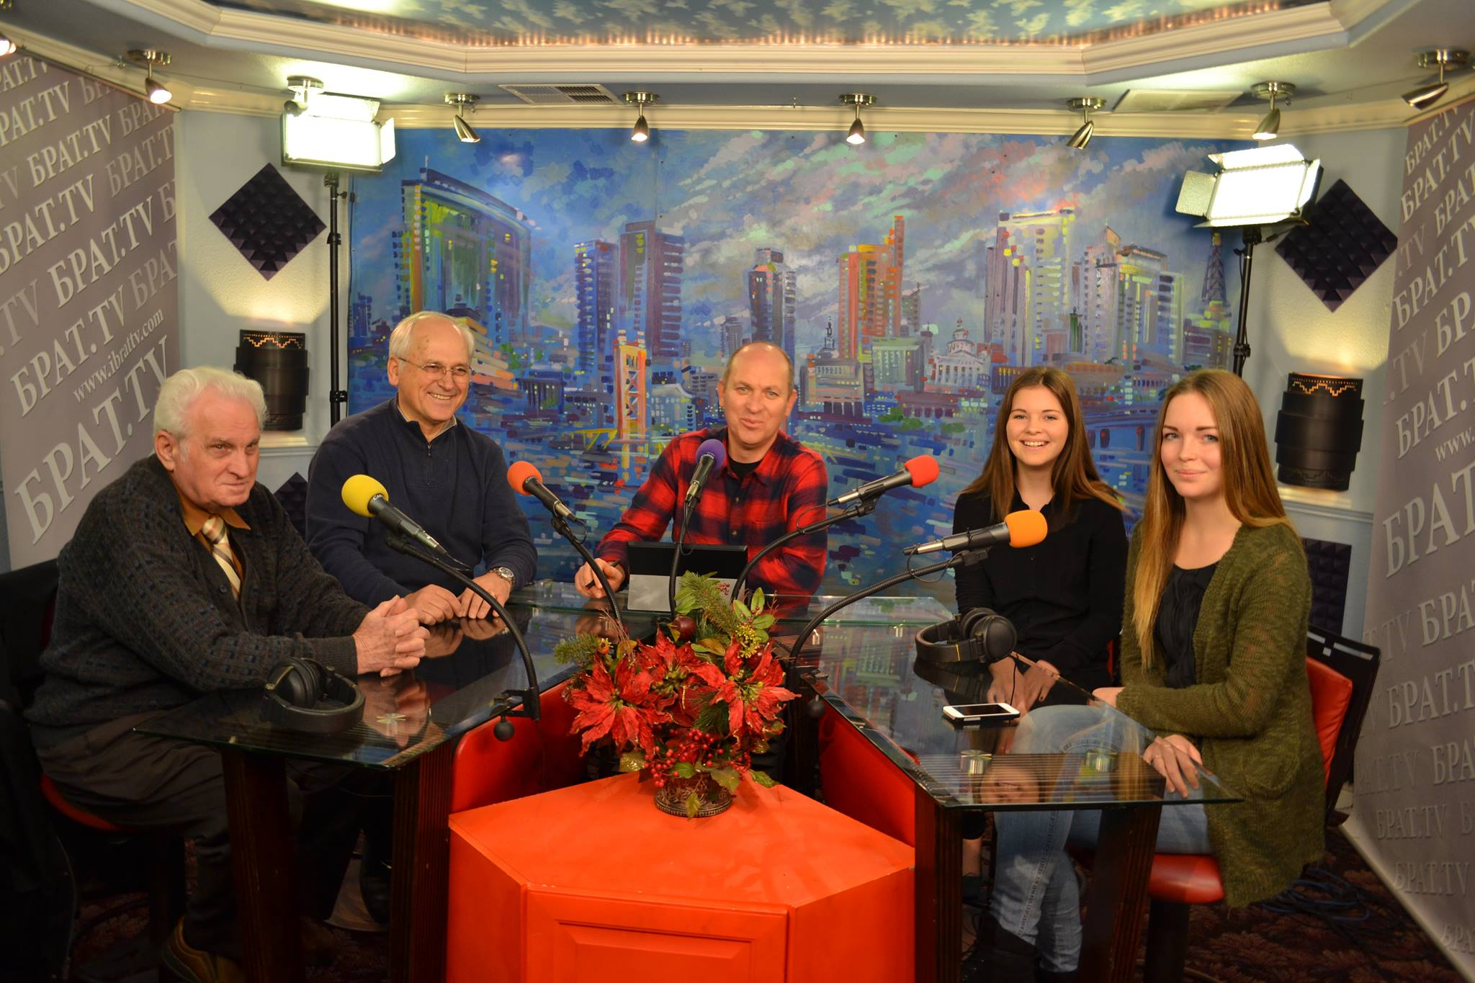
Culturally Appropriate Engagement Strategies/
Radio/TV Program – Cultural Differences (Youth, Adults, Seniors )

Slide 15
Hope for the Future Project
Mental Health Workshops
Peer Clubs
Focus groups
Media/Radio/TV Programs
Newspaper publications
Round Tables (clergies, mental health specialists)
“SafeTalk” Trainings
Community Events

Slide 16
SAC Suggestions/needs
Conduct more culturally responsive outreach and engagement with a focus on education, building relationships with churches and clergies and building trust within the community and reduce shame and stigma related to mental health.
Provide bilingual mental health services (no Russian-speaking psychiatrist for low income families).
Preventing substance/drug abuse among Russian-speaking community (no funds) by partnering with alcohol and drug service providers.

Slide 17
2117 Cottage Way,
Sacramento, CA 95825,
(916) 925-1071

